Slide 1
MODULE 2 CHAPTER 1: Introduction to Word Analysis

Slide 2
What is Word Analysis?
Word analysis is a process of learning more about word meanings by studying their origins and parts.
A “morpheme” is the smallest meaningful part of a word.
Other terms for word analysis:
Morphemic analysis
Word study

Slide 3
How is Word Analysis Important?
Words are more than a collection of letters: wonderful, review, disorder.
Students need to understand that words include more than one morpheme, each one with a story.
Analyzing words helps students see how words connect to cultures and linguistic patterns.

Slide 4
3.2 Regular Expressions
Notation to specify a language
Declarative
Sort of like a programming language.
Fundamental in some languages like perl and applications like grep or lex
Capable of describing the same thing as a NFA
The two are actually equivalent, so RE = NFA = DFA
We can define an algebra for regular expressions

Slide 5
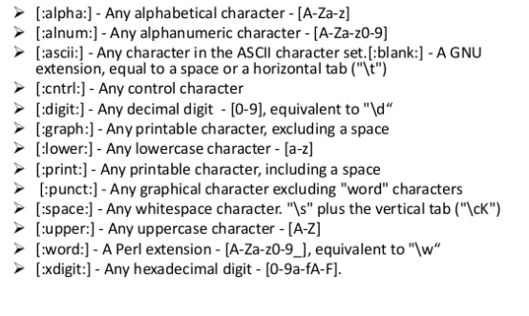
3.2.1 character classes

Slide 6
3.3 Finite-State Automate
A finite-state machine (FSM) or finite-state automaton (FSA, plural: automata), finite automaton, or simply a state machine, is a mathematical model of computation. It is an abstract machine that can be in exactly one of a finite number of states at any given time. The FSM can change from one state to another in response to some inputs; the change from one state to another is called a transition.An FSM is defined by a list of its states, its initial state, and the inputs that trigger each transition. Finite-state machines are of two types—deterministic finite-state machines and non-deterministic finite-state machines.A deterministic finite-state machine can be constructed equivalent to any non-deterministic one.

Slide 7
A Finite State Automaton (FSA) is a 5-tuple (Q, I, F, T, E)
where:
Q = states a finite set;
I = initial states a nonempty subset of Q;
F = final states a subset of Q;
T = an alphabet;
E = edges a subset of Q × (T + λ) × Q.
Some of the properties:
A finite set of states, one of which are designated the initial or start state, and one or more of which are designated as the final states.
A finite alphabet set, Σ consisting of input symbols.
A finite set of transitions that specify for each state and each symbol of the input alphabet, the state to which it next goes.

Slide 8
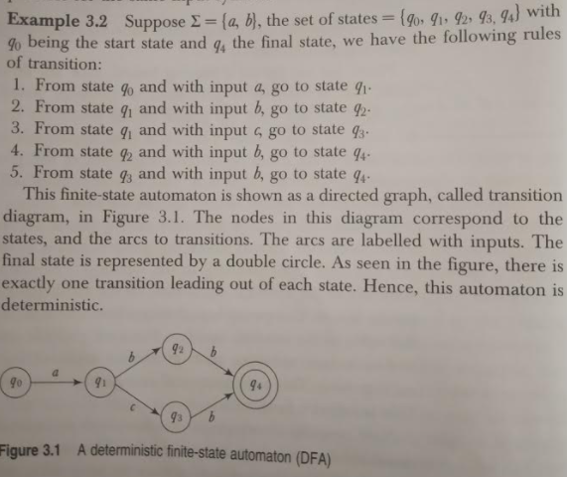

Slide 9
Deterministic Finite State Automaton (DFA) is defined as a 5 tuples
Q: Finite set of states
Σ: Finite Alphabet
δ: Transition function
total function from QxΣ to Q
: Initial/Start State
F : Set of final/accepting state

Slide 10
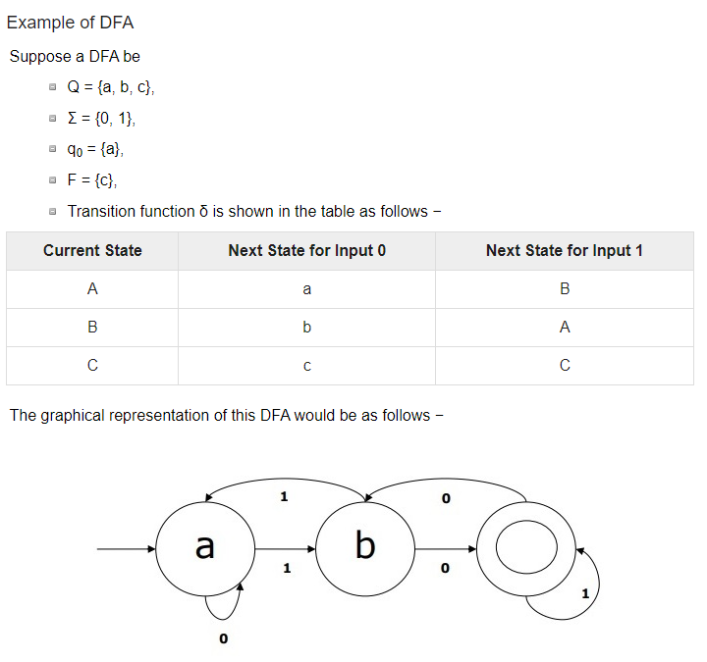

Slide 11
3.4 Morphological Parsing:
The term morphological parsing is related to the parsing of morphemes. We can define morphological parsing as the problem of recognizing that a word breaks down into smaller meaningful units called morphemes producing some sort of linguistic structure for it.
In other sense, we can say that morphology is the study of −
The formation of words.
The origin of the words.
Grammatical forms of the words.
Use of prefixes and suffixes in the formation of words.
How parts-of-speech (PoS) of a language are formed.

Slide 12
Morphemes can be divided into two types −
Stems
Affixes
Stems: It is the core meaningful unit of a word. We can also say that it is the root of the word. For example, in the word foxes, the stem is fox.
Affixes − As the name suggests, they add some additional meaning and grammatical functions to the words. For example, in the word foxes, the affix is − es.
Further, affixes can also be divided into following four types −
Prefixes − As the name suggests, prefixes precede the stem. For example, in the word unbuckle, un is the prefix.
Suffixes − As the name suggests, suffixes follow the stem. For example, in the word cats, -s is the suffix.
Infixes − As the name suggests, infixes are inserted inside the stem. For example, the word cupful, can be pluralized as cupsful by using -s as the infix.
Circumfixes − They precede and follow the stem. There are very less examples of circumfixes in English language. A very common example is ‘A-ing’ where we can use -A precede and -ing follows the stem.

Slide 13
A morphological parser uses following information sources:
Lexicon
The very first requirement for building a morphological parser is lexicon, which includes the list of stems and affixes along with the basic information about them. For example, the information like whether the stem is Noun stem or Verb stem, etc.
Morphotactics
It is basically the model of morpheme ordering. In other sense, the model explaining which classes of morphemes can follow other classes of morphemes inside a word. For example, the morphotactic fact is that the English plural morpheme always follows the noun rather than preceding it.
Orthographic rules
These spelling rules are used to model the changes occurring in a word. For example, the rule of converting y to ie in word like city+s = cities not citys.

Slide 14
3.5 Spelling Error and Corrections
I. INTRODUCTION: With the advent of the personal computer, it can be assumed that mistyping of words has increased. Thus, for many of us who do our own typing, the spell checkers in our word processors or other software have become indispensable.
Spell Checker has following steps:-
1. Take a word as input from a file.
2. Preprocess it.
3. Check in the word whether that word is available.
4. If it is available then move to next one.
5. If word is not present then spell checker will check the closest match word with it and put it in the form of suggestions.

Slide 15
Types of Errors: A. Typographic errors These errors are occurring when the correct spelling of the word is known but the word is mistyped by mistake. These errors are mostly related to the keyboard and therefore do not follow any linguistic criteria.
1. Single letter insertion; e.g. typing acress for cress.
2. Single letter deletion, e.g. typing acress for ctress
3. Single letter substitution, e.g. typing acress for across.
4. Transposition of two adjacent letters, e.g. typing acress for caress. The errors produced by any one of the above editing operations are also called single-errors

Slide 16
B. Cognitive errors: These are errors occurring when the correct spellings of the word are not known. In the case of cognitive errors, the pronunciation of misspelled word is the same or similar to the pronunciation of the intended correct word

Slide 17
Spelling error belongs to one of two distinct categories:
1)non-word errors
2)real-word errors
The two main technique use is
1)n-gram analysis
2)dictionary lookup

Slide 18
Spelling correction consists of detecting and correcting
In this we can see two problems:
1.Isolated-error detection and correction
2.Context-dependent error detection and correction.
The spelling correction algorithm broadly categorized by:

Slide 19
1)Minimum edit distance
2)Similarity key techniques
3)n-gram based techniques
4)Neural nets
5)Rule-based techniques.

Slide 20
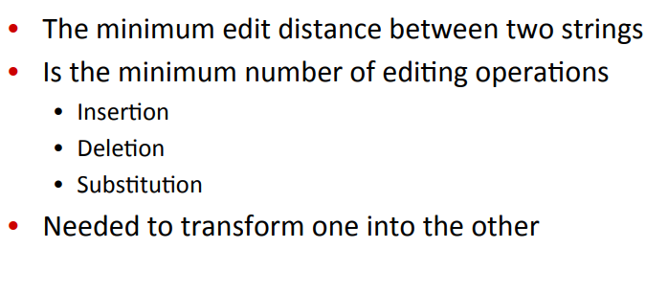
Minimum edit distance

Slide 21
Ex:the minimum edit distance between ‘tutor’ and ‘ tumor’ is 2
We substitute ‘m’ for ‘t’ and insert ‘u’ before ‘r’.
‘ed’ is a symmetric
For any two strings, s and t,ed(s,t) is always equal to ed(t,s)
Alignment shown here, between tutor and tumour has a distance of 2

Slide 22
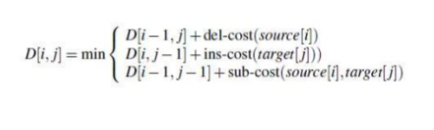
t u t o - r
t u m o u r
Another possible alignment for this is
t u t - o - r
t u - m o u r which has cost 3
The value in each cell is computed in terms of three possible paths.

Slide 23
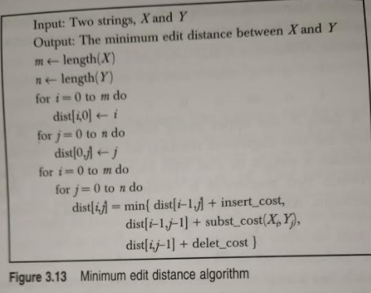

Slide 24
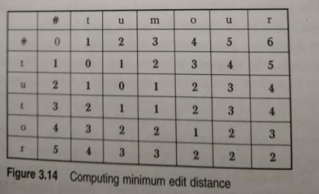

Slide 25
3.6 words and word classes
All words belong to categories called word classes (or parts of speech) according to the part they play in a sentence. The main word classes in English are listed below.
Noun
Verb
Adjective
Adverb
Pronoun
Preposition
Conjunction
Determiner
Exclamation

Slide 26
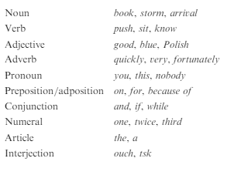
Part-of-speech example

Slide 27
3.7 Part of Speech Tagging
From a very small age, we have been made accustomed to identifying part of speech tags. For example, reading a sentence and being able to identify what words act as nouns, pronouns, verbs, adverbs, and so on. All these are referred to as the part of speech tags.
Part of speech tagging methods fall under the three general categories:
1) Rule-based(linguistic)
2)Stochastic(data-driven)
3)Hybrid

Slide 28
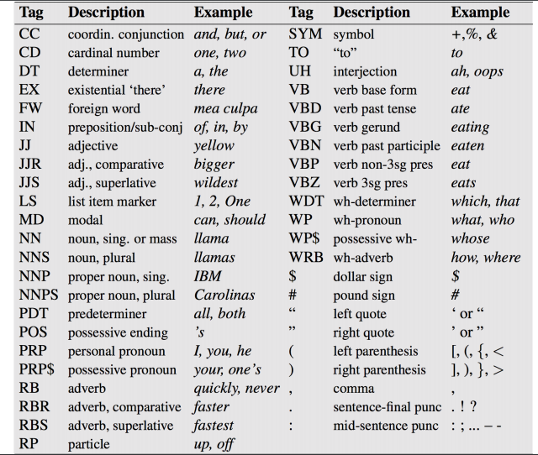
Tags from penn treebank tag set

Slide 29
1) Rule-based(linguistic)
One of the oldest techniques of tagging is rule-based POS tagging. Rule-based taggers use dictionary or lexicon for getting possible tags for tagging each word. If the word has more than one possible tag, then rule-based taggers use hand-written rules to identify the correct tag. Disambiguation can also be performed in rule-based tagging by analyzing the linguistic features of a word along with its preceding as well as following words. For example, suppose if the preceding word of a word is article then word must be a noun.

Slide 30
2)Stochastic(data-driven)
Another technique of tagging is Stochastic POS Tagging. Now, the question that arises here is which model can be stochastic. The model that includes frequency or probability (statistics) can be called stochastic. Any number of different approaches to the problem of part-of-speech tagging can be referred to as stochastic tagger.

Slide 31
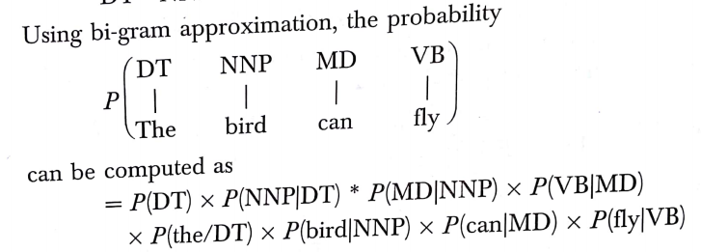
Ex: consider the sentence
“The bird can fly”
And tag sequence
DT NNP MD VB

Slide 32
3)Hybrid
Hybrid: Approaches to tagging combine the features of both the rule based and stochastic approaches, they use rules to assign tags to words
Example of hybrid approached is transformation based learning (TBL) of tags also called has Brill tagging

Slide 33
TBL Learner
Unannotated text
Lexicon
Initial state annotator
Truth(manually annotated text)
Annotated text (initial state)
Rules
Learner

Slide 34
TBL Tagging algorithm
Input: Tagged corpus and lexicon(with most frequent information)
Step1:Label every word with most likely tag(from dictionary)
Step2: check every possible transformation and select one which most improves tagging
Step3: Re-tag corpus applying the rules
Repeat 2-3 until some stopping criterion is reached
Result: Ranked sequence of transformation rules.

Slide 35
CHAPTER 2 4.1 Introduction to Syntactic Analysis
Parsing, syntax analysis, or syntactic analysis is the process of analyzing a string of symbols, either in natural language, computer languages or data structures, conforming to the rules of a formal grammar. The term parsing comes from Latin pars (orationis), meaning part (of speech).

Slide 36
4.2 Context-Free Grammar
Definition − A context-free grammar (CFG) consisting of a finite set of grammar rules is a quadruple (N, T, P, S) where
N is a set of non-terminal symbols.
T is a set of terminals where N ∩ T = NULL.
P is a set of rules, P: N → (N ∪ T)*, i.e., the left-hand side of the production rule P does have any right context or left context.
S is the start symbol.
Example
The grammar ({A}, {a, b, c}, P, A), P : A → aA, A → abc.
The grammar ({S, a, b}, {a, b}, P, S), P: S → aSa, S → bSb, S → ε
The grammar ({S, F}, {0, 1}, P, S), P: S → 00S | 11F, F → 00F | ε

Slide 37
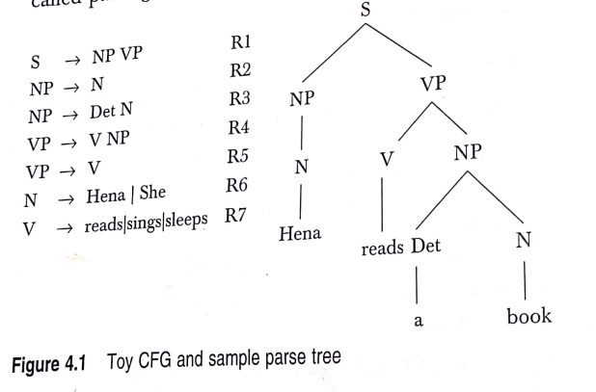
Example: Hena reads a book

Slide 38
4.3 Constituency
Constituency Parsing is the process of analyzing the sentences by breaking down it into sub-phrases also known as constituents. These sub-phrases belong to a specific category of grammar like NP (noun phrase) and VP(verb phrase).
Some of the major phrase types are:

Slide 39
4.3.1 Phrase Level Constructions: one of the simplest ways to decide whether a group of words is a phrase, is to see if it can be substituted with some other group of words without changing the meaning.
We can substitute a number of other phrases:
Hena reads a book.
Hena reads a storybook
Those girls read a book.
She reads a comic book.

Slide 40
Noun Phrase
A noun phrase is any noun or pronoun along with its modifiers:
Example :The school children Yesterday’s newspaper An old and rusted slinky
Verb Phrase
A verb phrase is any number of verbs working together:
example :Had been sleeping Will contact May have written
Verb phrases often contain adverbs that change the meaning of the phrase:
Example :Has never lost May not trespass Am always looking

Slide 41
Prepositional Phrase
A prepositional phrase always starts with a preposition and ends with a noun or pronoun (and its modifiers) that is called the object of the preposition:
Example: Through the wheat field
Preposition: through
Object of the preposition: the wheat field
Here are some more examples of prepositional phrases:
During the year Despite complaints In the summer

Slide 42
Adjective Phrase: AP consist of an adjective, which may be preceded by an adverb and followed by a PP
Example: Ashish is clever
The train is very late
my sister is found of animals.
The phrase structure rule for adjective phrase is
AP->(Adv) Adj(PP)

Slide 43
Adverb Phrase: An adverb phrase consists of an adverb, possibly preceded by a degree adverb. Hence is an Example.
Time passes very quickly
AdvP->(Intens)Adv

Slide 44
Parsing
POS tags give information about the individual words, and their internal form (eg sing vs plur, tense of verb)
Additional level of information concerns the way the words relate to each other
the overall structure of each sentence
the relationships between the words
This can be achieved by parsing the corpus

Slide 45
Parsing – overview
What sort of information does parsing add?
What are the difficulties relating to parsing?
How is parsing done?
Parsing and corpora
partial parsing, chunking
stochastic parsing
treebanks

Slide 46
Structural information
Parsing adds information about sentence structure and constituents
Allows us to see what constructions words enter into
eg, transitivity, passivization, argument structure for verbs
Allows us to see how words function relative to each other
eg, what words can modify / be modified by other words

Slide 47
Top Down Parsing

Slide 48
Introduction
A Top-down parser tries to create a parse tree from the root towards the leafs scanning input from left to right
It can be also viewed as finding a leftmost derivation for an input string
Example: id+id*id
E -> TE’
E’ -> +TE’ | Ɛ
T -> FT’
T’ -> *FT’ | Ɛ
F -> (E) | id
E
E
E
E
E
E
lm
lm
lm
lm
lm
T
E’
T
E’
T
E’
T
E’
T
E’
F
T’
F
T’
F
T’
F
T’
+
T
E’
id
id
Ɛ
id
Ɛ

Slide 49
Recursive descent parsing
Consists of a set of procedures, one for each nonterminal
Execution begins with the procedure for start symbol
A typical procedure for a non-terminal
void A() {
choose an A-production, A->X1X2..Xk
for (i=1 to k) {
if (Xi is a nonterminal
call procedure Xi();
else if (Xi equals the current input symbol a)
advance the input to the next symbol;
else /* an error has occurred */
}
}

Slide 50
Recursive descent parsing (cont)
General recursive descent may require backtracking
The previous code needs to be modified to allow backtracking
In general form it cant choose an A-production easily.
So we need to try all alternatives
If one failed the input pointer needs to be reset and another alternative should be tried
Recursive descent parsers cant be used for left-recursive grammars

Slide 51
Example
S->cAd
A->ab | a
Input: cad
S
S
S
c
A
d
c
A
d
c
A
d
a
b
a

Slide 52
First and Follow
First() is set of terminals that begins strings derived from
If α=>ɛ then is also in First(ɛ)
In predictive parsing when we have A-> α|β, if First(α) and First(β) are disjoint sets then we can select appropriate A-production by looking at the next input
Follow(A), for any nonterminal A, is set of terminals a that can appear immediately after A in some sentential form
If we have S => αAaβ for some αand βthen a is in Follow(A)
If A can be the rightmost symbol in some sentential form, then $ is in Follow(A)
*
*

Slide 53
Computing First
To compute First(X) for all grammar symbols X, apply following rules until no more terminals or ɛ can be added to any First set:
If X is a terminal then First(X) = {X}.
If X is a nonterminal and X->Y1Y2…Yk is a production for some k>=1, then place a in First(X) if for some i a is in First(Yi) and ɛ is in all of First(Y1),…,First(Yi-1) that is Y1…Yi-1 => ɛ. if ɛ is in First(Yj) for j=1,…,k then add ɛ to First(X).
If X-> ɛ is a production then add ɛ to First(X)
Example!
*
*

Slide 54
Computing follow
To compute First(A) for all nonterminals A, apply following rules until nothing can be added to any follow set:
Place $ in Follow(S) where S is the start symbol
If there is a production A-> αBβ then everything in First(β) except ɛ is in Follow(B).
If there is a production A->B or a production A->αBβ where First(β) contains ɛ, then everything in Follow(A) is in Follow(B)
Example!

Slide 55
LL(1) Grammars
Predictive parsers are those recursive descent parsers needing no backtracking
Grammars for which we can create predictive parsers are called LL(1)
The first L means scanning input from left to right
The second L means leftmost derivation
And 1 stands for using one input symbol for lookahead
A grammar G is LL(1) if and only if whenever A-> α|βare two distinct productions of G, the following conditions hold:
For no terminal a do αandβ both derive strings beginning with a
At most one of α or βcan derive empty string
If α=> ɛ then βdoes not derive any string beginning with a terminal in Follow(A).
*

Slide 56
Construction of predictive parsing table
For each production A->α in grammar do the following:
For each terminal a in First(α) add A-> in M[A,a]
If ɛ is in First(α), then for each terminal b in Follow(A) add A-> ɛ to M[A,b]. If ɛ is in First(α) and $ is in Follow(A), add A-> ɛ to M[A,$] as well
If after performing the above, there is no production in M[A,a] then set M[A,a] to error

Slide 57
Example
First
Follow
F
T
E
E’
T’
{(,id}
{+, *, ), $}
E -> TE’
E’ -> +TE’ | Ɛ
T -> FT’
T’ -> *FT’ | Ɛ
F -> (E) | id
{(,id}
{+, ), $}
{(,id}
{), $}
{+,ɛ}
{), $}
{*,ɛ}
{+, ), $}
Input Symbol
Non -
terminal
id
+
*
(
)
$
E
E’
T
T’
F
E -> TE’
E -> TE’
E’ -> +TE’
E’ -> Ɛ
E’ -> Ɛ
T -> FT’
T -> FT’
T’ -> Ɛ
T’ -> *FT’
T’ -> Ɛ
T’ -> Ɛ
F -> id
F -> (E)

Slide 58
Another example
S -> iEtSS’ | a
S’ -> eS | Ɛ
E -> b
Input Symbol
Non -
terminal
a
b
e
i
t
$
S
S’
E
S -> a
S -> iEtSS’
S’ -> Ɛ
S’ -> eS
S’ -> Ɛ
E -> b

Slide 59
Non-recursive predicting parsing
a
+
b
$
Predictive
parsing
program
output
stack
X
Y
Z
$
Parsing
Table
M

Slide 60
Predictive parsing algorithm
Set ip point to the first symbol of w;
Set X to the top stack symbol;
While (X<>$) { /* stack is not empty */
if (X is a) pop the stack and advance ip;
else if (X is a terminal) error();
else if (M[X,a] is an error entry) error();
else if (M[X,a] = X->Y1Y2..Yk) {
output the production X->Y1Y2..Yk;
pop the stack;
push Yk,…,Y2,Y1 on to the stack with Y1 on top;
}
set X to the top stack symbol;
}

Slide 61
Example
id+id*id$
Matched
Stack
Input
Action
E$
id+id*id$

Slide 62
Error recovery in predictive parsing
Panic mode
Place all symbols in Follow(A) into synchronization set for nonterminal A: skip tokens until an element of Follow(A) is seen and pop A from stack.
Add to the synchronization set of lower level construct the symbols that begin higher level constructs
Add symbols in First(A) to the synchronization set of nonterminal A
If a nonterminal can generate the empty string then the production deriving can be used as a default
If a terminal on top of the stack cannot be matched, pop the terminal, issue a message saying that the terminal was insterted

Slide 63
Example
Non -
terminal
Input Symbol
id
+
*
(
)
$
E
E’
T
T’
F
E -> TE’
E -> TE’
synch
synch
E’ -> +TE’
E’ -> Ɛ
E’ -> Ɛ
T -> FT’
synch
T -> FT’
synch
synch
T’ -> Ɛ
T’ -> *FT’
T’ -> Ɛ
T’ -> Ɛ
F -> id
synch
synch
F -> (E)
synch
synch
Stack
Input
Action
E$
)id*+id$
Error, Skip )
E$
id*+id$
id is in First(E)
TE’$
id*+id$
FT’E’$
id*+id$
idT’E’$
id*+id$
T’E’$
*+id$
*FT’E’$
*+id$
FT’E’$
+id$
Error, M[F,+]=synch
T’E’$
+id$
F has been poped

Slide 64
Bottom-up Parsing

Slide 65
Introduction
Constructs parse tree for an input string beginning at the leaves (the bottom) and working towards the root (the top)
Example: id*id
E -> E + T | T
T -> T * F | F
F -> (E) | id
F
E
id*id
F * id
T * id
T * F
id
F
F
id
T * F
F
id
id
F
id
T * F
id
F
id
id

Slide 66
Shift-reduce parser
The general idea is to shift some symbols of input to the stack until a reduction can be applied
At each reduction step, a specific substring matching the body of a production is replaced by the nonterminal at the head of the production
The key decisions during bottom-up parsing are about when to reduce and about what production to apply
A reduction is a reverse of a step in a derivation
The goal of a bottom-up parser is to construct a derivation in reverse:
E=>T=>T*F=>T*id=>F*id=>id*id

Slide 67
Handle pruning
A Handle is a substring that matches the body of a production and whose reduction represents one step along the reverse of a rightmost derivation
Right sentential form
Handle
Reducing production
id*id
id
F->id
F*id
F
T->F
T*id
id
F->id
T*F
T*F
E->T*F

Slide 68
Shift reduce parsing
A stack is used to hold grammar symbols
Handle always appear on top of the stack
Initial configuration:
Stack Input
$ w$
Acceptance configuration
Stack Input
$S $

Slide 69
Shift reduce parsing (cont.)
Basic operations:
Shift
Reduce
Accept
Error
Example: id*id
Stack
Input
Action
$
id*id$
shift
$id
*id$
reduce by F->id
$F
*id$
reduce by T->F
$T
*id$
shift
$T*
id$
shift
$T*id
$
reduce by F->id
$T*F
$
reduce by T->T*F
$T
$
reduce by E->T
$E
$
accept

Slide 70
Handle will appear on top of the stack
S
S
A
B
B
A
α
β
γ
z
α
γ
z
y
x
y
Stack
Input
Stack
Input
$αβγ
yz$
$αγ
xyz$
$αβB
yz$
$αBxy
z$
$αβBy
z$

Slide 71

Conflicts during shit reduce parsing
Two kind of conflicts
Shift/reduce conflict
Reduce/reduce conflict
Example:
Stack
Input
… if expr then stmt
else …$

Slide 72
Reduce/reduce conflict
stmt -> id(parameter_list)
stmt -> expr:=expr
parameter_list->parameter_list, parameter
parameter_list->parameter
parameter->id
expr->id(expr_list)
expr->id
expr_list->expr_list, expr
expr_list->expr
Stack
Input
… id(id
,id) …$

Slide 73
LR Parsing
The most prevalent type of bottom-up parsers
LR(k), mostly interested on parsers with k<=1
Why LR parsers?
Table driven
Can be constructed to recognize all programming language constructs
Most general non-backtracking shift-reduce parsing method
Can detect a syntactic error as soon as it is possible to do so
Class of grammars for which we can construct LR parsers are superset of those which we can construct LL parsers

Slide 74
Earley Parser:
The state set at input position k is called S(k). The parser is seeded with S(0) consisting of only the top-level rule. The parser then repeatedly executes three operations: prediction, scanning, and completion.
Prediction: For every state in S(k) of the form (X → α • Y β, j) (where j is the origin position as above), add (Y → • γ, k) to S(k) for every production in the grammar with Y on the left-hand side (Y → γ).
Scanning: If a is the next symbol in the input stream, for every state in S(k) of the form (X → α • a β, j), add (X → α a • β, j) to S(k+1).
Completion: For every state in S(k) of the form (Y → γ •, j), find all states in S(j) of the form (X → α • Y β, i) and add (X → α Y • β, i) to S(k).

